Slide 1
PROFESSIONAL REGISTRATION
How is it for you?
Hayden Llewellyn, Chief Executive

Slide 2
SESSION OVERVIEW
EWC remit
Registration of WBL practitioners
Code of Professional Conduct & Practice
Fitness to practise cases
EWC services, support, events
Your feedback

Slide 3
WHAT ARE THE AIMS OF THE EWC?
To contribute to improving standards of teaching and quality of learning in Wales
To maintain and improve standards of professional conduct amongst teachers and others who support teaching and learning in Wales
To maintain public trust, confidence and to safeguard the interests of learners, parents and general public
Register of persons deemed suitable to practice within the education workforce
Investigate and hear cases against registered persons involving professional misconduct, incompetence or criminal offences
Code of Professional Conduct and Practice
Accredit school teacher initial programmes
Advice to WG about registrant groups and teaching & learning
Hold and provide information about the education workforce
Keep itself informed about the Induction of registrants and hear appeals
Promotion careers in the registrant professions (on WG request)
Additional work on behalf of the Welsh Government

Slide 4
THE EWC – WHO IS REGISTERED?
GTCW renamed as the Education Workforce Council (EWC) on 1 April 2015
As at 31st March 2018 | When | Number | Extra category
School teachers | 2001 | 35,571 | 443
FE teachers | April 2015 | 5,856 | 626
School learning support workers | April 2016 | 32,531 | 3,414
FE learning support workers | April 2016 | 2,546 | 2,240
Work-based learning practitioners | April 2017 | 2,562 | 246
Youth workers | April 2017 | 367 | 20
Youth support workers | April 2017 | 637 | 48
Total |  | 80,070 | 7,037

Slide 5

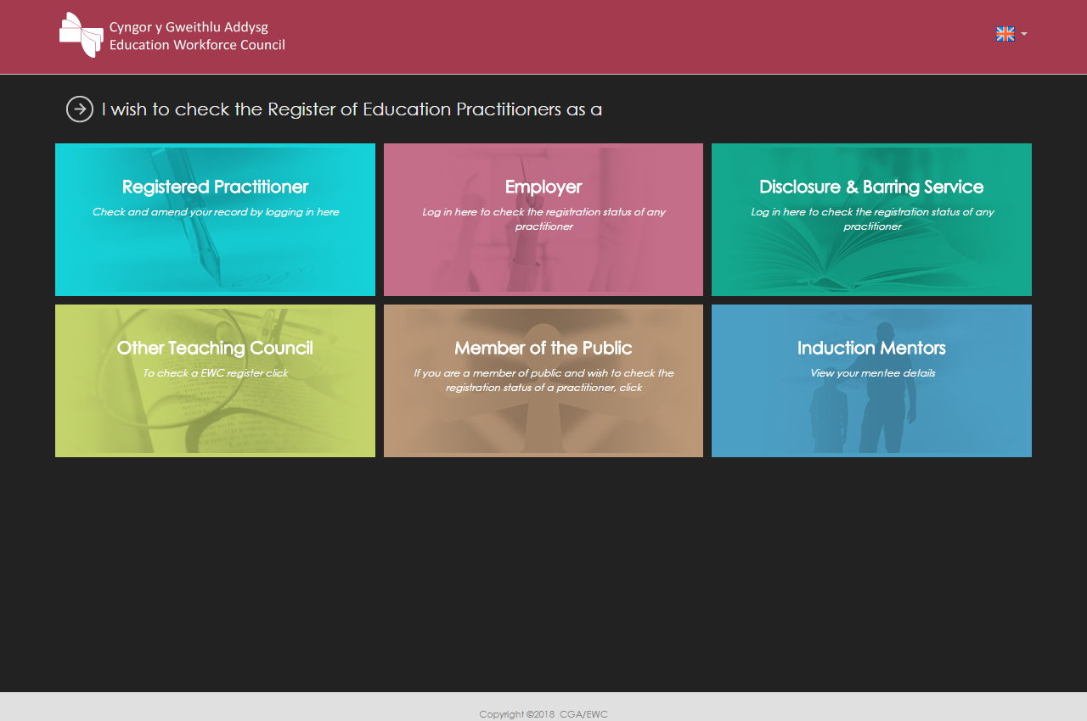
MAKING SURE YOU COMPLY
BEFORE starting – application pack. Online in Autumn
Check the Register. You are not using it! (Under 1,000)
Annual re-registration / fee collection. WBL = 2,449 (plus 169)
Changes to sub-contractors
FE colleges
WG Tenders

Slide 6
DATA ABOUT WBL PRACTITIONERS
Update your record on Register
Recent letter to registrants
First public data released this month
Data such as:
  Age
  Gender
  Qualifications
  Ethnic group
  Disability
  Qualifications
  Welsh language ability

Slide 7
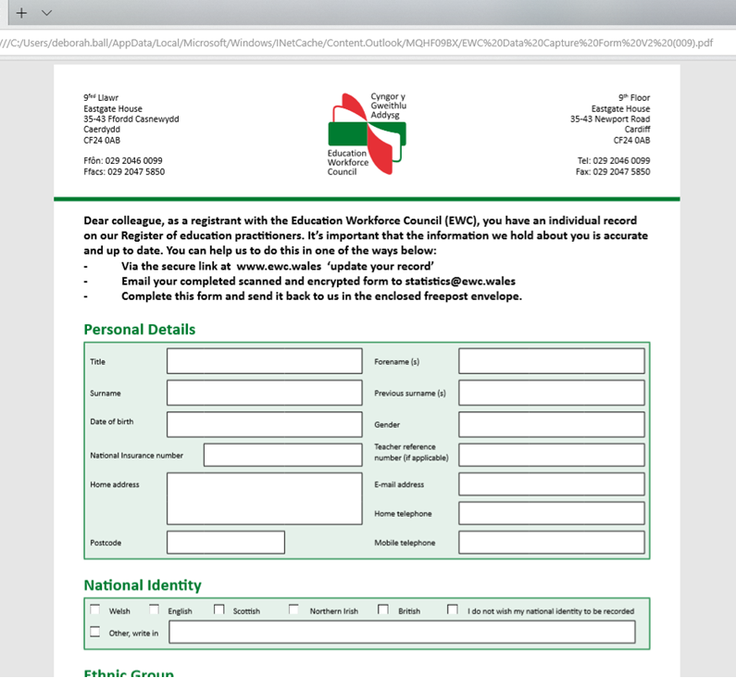

Slide 8

THE CODE
  What is it?
  Sets out the key principles of
  good conduct and practice
  Should guide your judgement and decisions
  Informs parents, guardians, learners, general public of the standards they can expect from you
  What can happen?
  Failure to comply with the Code may call your registration into question
  Help in understanding it?
  EWC good practice guides e.g.
    Social media use
    Testing, assessment, examinations, invigilation
    Restraint, touch, contact
  Consultation
  September to December
  New Code live from May 2019

Slide 9

REFERRAL OF CASES TO EWC
Criminal offences (conviction, caution, reprimand, warning, bind over, fixed penalty notice)
Dismissal / resignation allegations of misconduct, professional incompetence or conviction of a relevant offence
Other
Including from the DBS or complaints (parent, learner, colleague, public)
Police forces may refer
Employer
Complainant
Any cases involving harm or risk of harm to children are referred to the DBS
Any cases involving harm or risk of harm to children are referred to the DBS

Slide 10

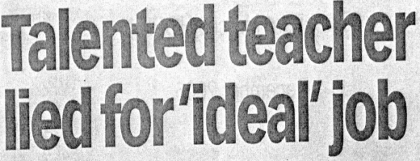


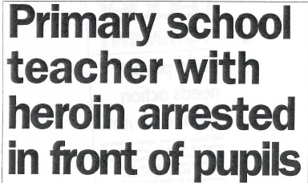
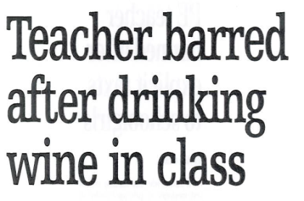
Teacher who showered with pupils is struck off
Teacher sent hundreds of emails to school girl
Lecturer banned from organising school trips after booze-fuelled London outing
Head teacher 'driven by results' is struck off after she manipulated test results
Wrexham cannabis farm
teacher banned from
profession
Teacher who sent picture of his bottom to ex-pupil is struck off
Construction lecturer who used 'building site banter' banned from the classroom
Deputy head banned for sex with teens
Lecturer who’s class was like a ‘war zone’ is prohibited
Teacher forged forms to help friend's daughter jump the queue to a popular primary school
Teacher boasted
about sex with pupil
FE teacher who told learners he loved having ‘a bit of Charlie’ is struck off
Primary school teaching assistant found ‘staggering’ and smelling of alcohol too drunk to catch bus home
Deputy headteacher struck off for having sex with teenage schoolgirls
Teacher who 'spent hours' on Facebook during class guilty of misconduct
A former teacher is banned from teaching after sexual relationships with two girls
Lecturer 'hit' pupil on the head with file
Foul-mouthed teacher BANNED from classroom for swearing at pupils

Slide 11
FITNESS TO PRACTISE
16 live cases involving conduct, competence or criminal offences
53 registration cases where “issues” considered. 1 refusal of registration
7 WBL registrants appointed as panel members

Slide 12
GET THE MOST FROM EWC REGISTRATION
Use our services
Presentations, training, support
  Code, Fitness to Practise, social media
  Professional Learning Passport (PLP)
PLP, EBSCO
Code and good practice guides
Research bursary programme
Stay informed
Brief your staff
Termly e-mails, e-news, website, twitter, employer communication
Free events – lectures, policy briefings, conferences
Get involved
FTP panel member, blogs, your views, working groups, surveys
Tell us what you want from us

Slide 13

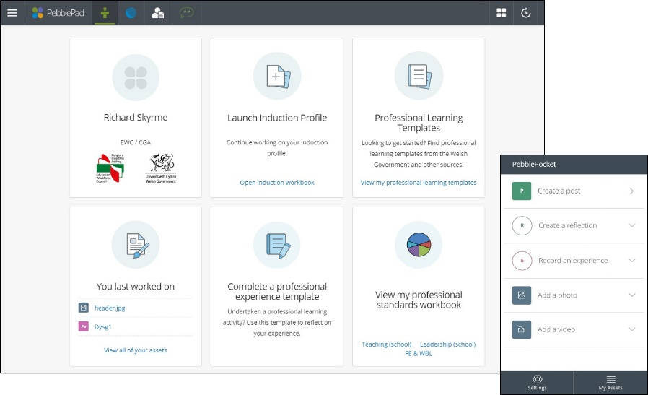


EBSCO
Your PLP

Slide 14
EVENTS
“Empowering Education in Wales” with Jenny Gore and Professor John Furlong – 22nd May 2018
Professionally Speaking “A natural education” with Iolo Williams – 22nd October 2018
Policy briefing on the Welsh Language – November 2018

Slide 15
YOUR FEEDBACK

Slide 16





hayden.llewellyn@ewc.wales
02920 460099
Contact us
@ewc_cga
www.ewc.wales
Subscribe to newsletter

