Slide 1


Symud y tu hwnt i’r weledigaeth
Moving beyond
the Vision
Nikki Lawrence - Prif Weithredwr/ Chief Executive
Phil Bowden – Pennaeth Ansawdd a Chynllunio/ Head of Quality and Planning

Slide 2
Structure
Digitalisation
Priorities
EBE
Outcomes
Data

Slide 3

Restructuring of the organisation
Reduction in management costs
Alignment of “senior” team into functions
Disinvestment and redeployment

Slide 4



Our vision has three key priorities:
A strong focus on young people
Services that support schools to develop the Careers and the World of Work curriculum and education business link activities
Utilising and embracing digital technology

Slide 5

Changing Lives - Key Priority 1
Stronger focus on young people
Careers Advisers working with schools to achieve the best outcomes for young people
Supporting all young people whatever their ability or need through a blend of face to face and digital services
To increase young peoples career management skills and help them make effective career decisions and good transitions

Slide 6
Career Discovery
Model

Slide 7

Changing Lives - Key Priority 2
Services to support other organisations to help young people develop their careers
The Curriculum Team and Business Education Advisers supporting schools and businesses through facilitating education business links and supporting the Careers and World of work curriculum
To provide young people with a range of employer and careers related experiences as part of a strengthened careers and work related curriculum

Slide 8

Changing Lives - Key Priority 3
Utilising and Embracing Digital Technology
Engaging clients through a range of approaches using technology and providing services through different channels

Slide 9
Deliver services focused on contributing to key outcomes:
Improved efficiency of labour markets by reducing skills mismatches
Increasing participation and attainment in education and training and reducing the number of young people who are NEET
Reducing drop out and “churn” within post 16 education and training
Increasing the take up of apprenticeships
Help other agencies to target their services more efficiently and effectively
Help ensure the new Curriculum for Wales prepares young people for the world of work

Slide 10
Changing Lives
Engaging Business
gyrfacymru.com | careerswales.com

Slide 11
Engaging Business
We will deliver a suite of services to include:-
STEM activities tailored for the local economy
Brokerage of employer visits and presentations in schools, as well as site visits
Enterprise activities
Activities that challenge gender stereotyping
Vocational and/or sectoral webinars
Mock interviews and employer support for transition
Employer led skills competitions

Slide 12

Engaging Business
We will work with schools to support education business links through the new Education Business Exchange (EBE)
EBE will be rolled out over a 3-year period and will enable teachers to search an extensive database of employers who are prepared to support schools in the delivery of the curriculum.
We aim to have at least 10,000 employers on EBE with all schools trained in its use by 2020.

Slide 13
Engaging Business
Our new offer also includes:
The introduction of Business Champion training for employers from September 2017 (Pilot in first year, with wider roll out planned in 2018/19).
Potential development of a Business Award to acknowledge the value of employer input into the school curriculum.

Slide 14
Engaging Business
Pilot of Gatsby benchmark
Pilot of Gatsby benchmarks in one Local Authority
Gatsby published “ The Good Career Guidance Report”
Identified 8 benchmarks – for schools to use to improve careers provision

Slide 15
Changing Lives
Digitalisation
gyrfacymru.com | careerswales.com

Slide 16

Digitalisation

Slide 17
Digitalisation
To summarise, we now offer CIAG services through the following channels:
Video interviews
Telephone
Webchat
Email
Social media
And we are developing exciting new methods of supporting Career Discovery using:
Virtual Reality
Interactive audience response tools
Careers Wales TV – our new interactive streaming service

Slide 18
Changing Lives
Data
gyrfacymru.com | careerswales.com

Slide 19

Data
Data-based planning is at the heart of
Changing Lives

Slide 20

Data
The Diagnosis element of the Career Discovery Model utilises online assessments and other tools.
The data derived from this drives both the young person’s journey of career Discovery, enabling them to find out more about their interests and widening their horizons to other options
And the bespoke Delivery of services by Careers Wales

Slide 21
Data
The Delivery element is overseen by Careers Advisers, who now have an Account Executive function in each school
They analyse they data on an individual and cohort basis
And co-ordinate Careers Wales’ input to the school, including from the curriculum support and business engagement teams
As well as helping to school to plan their own input
ensuring that everything is complementary and tailored to the specific needs of the pupils in the school

Slide 22
Data - Career Check
A key source of data is gathered via our “Career Check” survey. Here is an example of how we convert data into delivery;
• We offer the survey to pupils in all schools. In 2018 around 82% of pupils, 25,000, completed it.
• Career Check explores occupation choice by sector, preferred destination by route i.e. FE, WBL, school and by the young person’s ability to manage their career.
• The results can be analysed at a Wales, regional, local authority or school level.

Slide 23
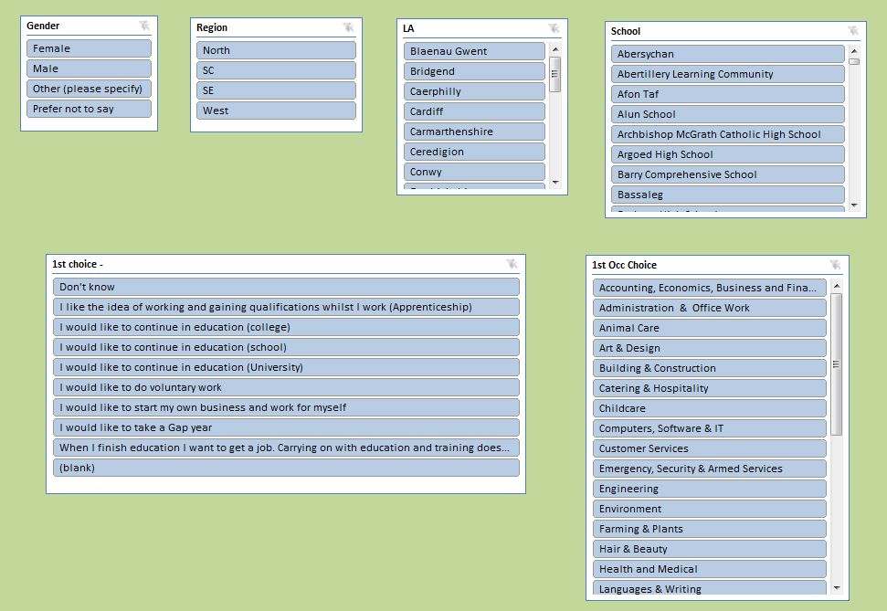
Data - Career Check

Slide 24
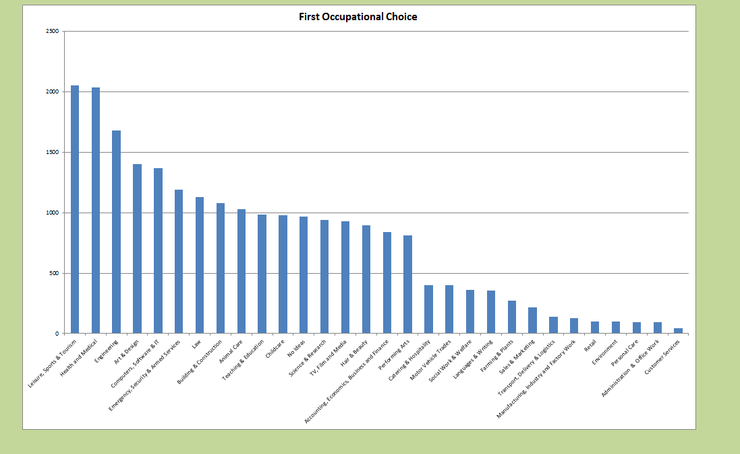
Data - Career Check

Slide 25
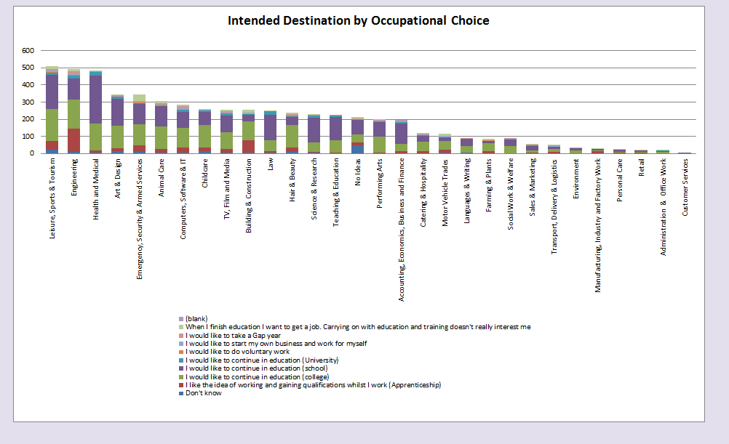
Data - Career Check

Slide 26
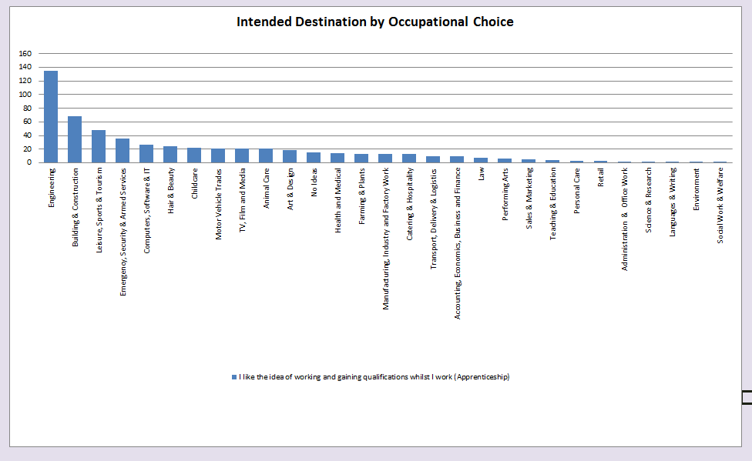
Data - Career Check

Slide 27
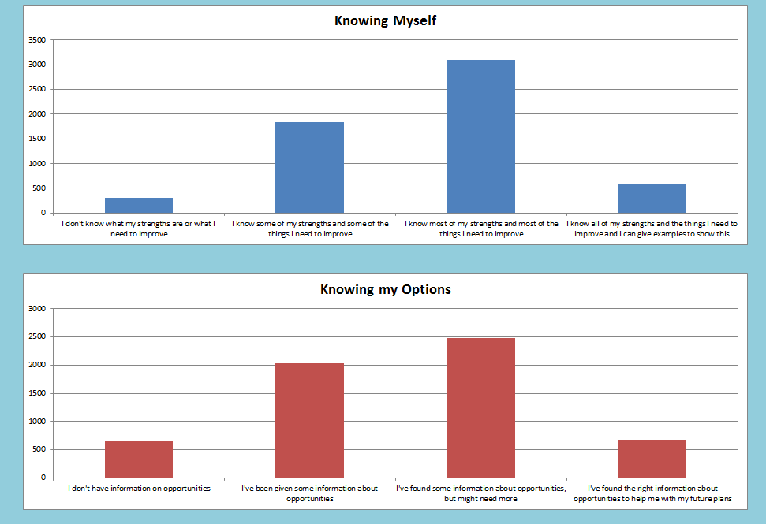
Data - Career Check

Slide 28
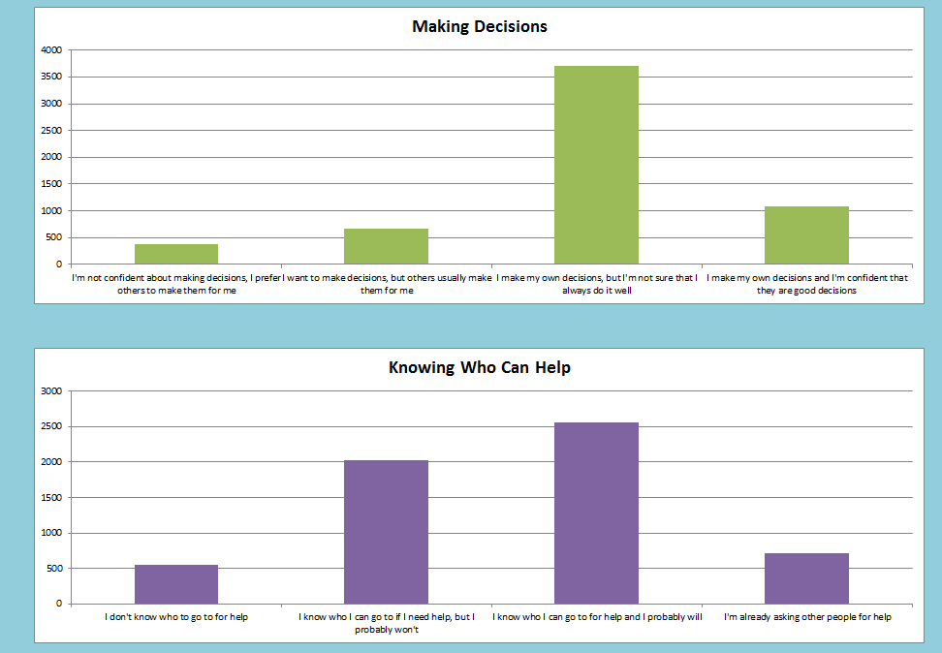
Data - Career Check

Slide 29
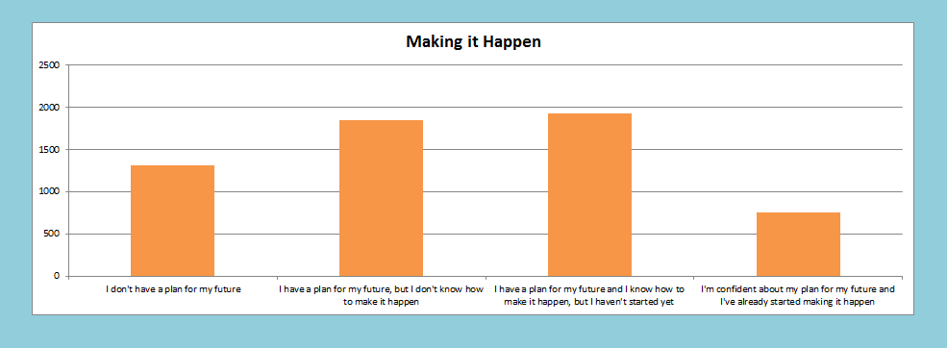
Data - Career Check

Slide 30
Data - Career Check
Career check is well established as a way of informing delivery in schools. We have even seen areas where KS5 offers have been changed as a result of Career Check data.
We share Careers Check data with the 3 RSPs to help inform their work.
Moving forward, would it be useful to share this data with providers to support provision planning?

Slide 31
Unrhyw gwestiwn?
Any questions?
Diolch / Thank You

